Slide 1
Network connectivity
Unit 5

Slide 2
introduction
Python provides two levels of access to network services. At a low level, you can access the basic socket support in the underlying operating system, which allows you to implement clients and servers for both connection-oriented and connectionless protocols.
Python also has libraries that provide higher-level access to specific application-level network protocols, such as FTP, HTTP, and so on.

Slide 3
What is Socket?
Sockets are the endpoints of a bidirectional communications channel. Sockets may communicate within a process, between processes on the same machine, or between processes on different continents.
Sockets may be implemented over a number of different channel types: Unix domain sockets, TCP, UDP, and so on. The socket library provides specific classes for handling the common transports as well as a generic interface for handling the rest.

Slide 4
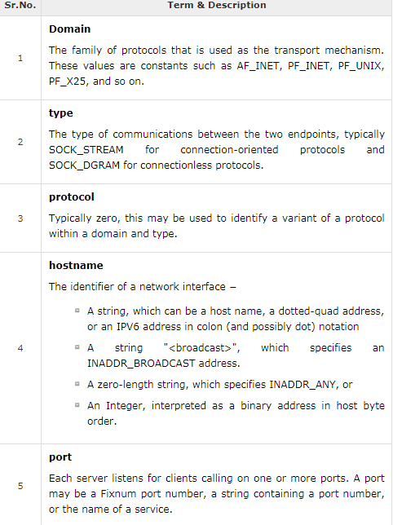

Slide 5
The socket Module
To create a socket, you must use the socket.socket() function available in socket module, which has the general syntax −
Here is the description of the parameters −
socket_family − This is either AF_UNIX or AF_INET, as explained earlier.
socket_type − This is either SOCK_STREAM or SOCK_DGRAM.
protocol − This is usually left out, defaulting to 0.
Once you have socket object, then you can use required functions to create your client or server program.

Slide 6
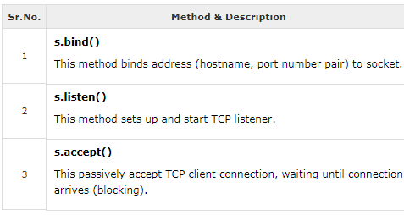
Server Socket Methods

Slide 7
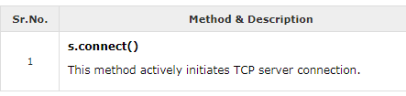
Client Socket Methods

Slide 8
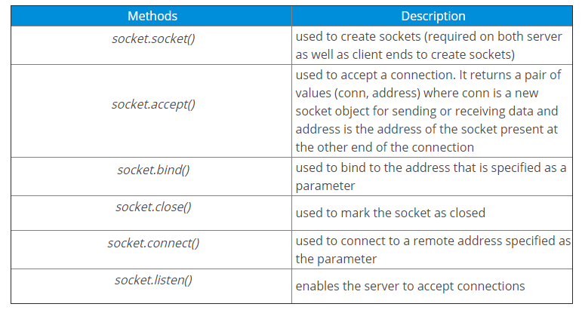

Slide 9
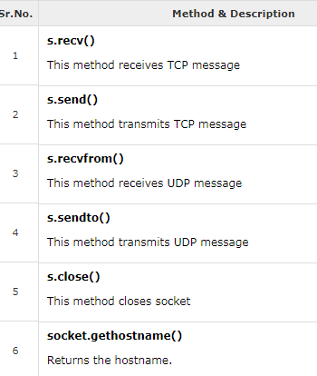
General Socket Methods

Slide 10
What is a Server?
A server is either a program, a computer, or a device that is devoted to managing network resources. Servers can either be on the same device or computer or locally connected to other devices and computers or even remote. There are various types of servers such as database servers, network servers, print servers, etc.
Servers commonly make use of methods like socket.socket(), socket.bind(), socket.listen(), etc to establish a connection and bind to the clients. Now let’s write a program to create a server. Consider the following example:

Slide 11
#This is server.py file
import socket
# create a socket object
serversocket = socket.socket(socket.AF_INET, socket.SOCK_STREAM)
# get local machine name
host = socket.gethostname()
print(host)
port = 9999
# bind to the port
serversocket.bind((host, port))
# queue up to 5 requests
serversocket.listen(5)
while True:
# establish a connection
clientsocket,addr = serversocket.accept()
print("Got a connection from %s" % str(addr))
msg = 'Thank you for connecting'+ "\r\n"
clientsocket.send(msg.encode('ascii'))
clientsocket.close()

Slide 12
NOTE:
AF_INET refers to Address from the Internet and it requires a pair of (host, port) where the host can either be a URL of some particular website or its address and the port number is an integer. SOCK_STREAM is used to create TCP Protocols.
The bind() method accepts two parameters as a tuple (host, port). However, it’s better to use 4-digit port numbers as the lower ones are usually occupied. The listen() method allows the server to accept connections. Here, 5 is the queue for multiple connections that come up simultaneously. The minimum value that can be specified here is 0 (If you give a lesser value, it’s changed to 0). In case no parameter is specified, it takes a default suitable one.
The while loop allows accepting connections forever. ‘clientsocket,addr ‘ are the client object and address. The print statement just prints out the address and the port number of the client socket. Finally, clientsocket.send is used to send the data in bytes.
We can obtain host address by using socket.gethostname() function. It is recommended to user port address above 1024 because port number lesser than 1024 are reserved for standard internet protocol.

Slide 13
What is a Client?
A client is either a computer or software that receives information or services from the server. In a client-server module, clients requests for services from servers. The best example is a web browser such as Google Chrome, Firefox, etc. These web browsers request web servers for the required web pages and services as directed by the user. Other examples include online games, online chats, etc.

Slide 14
# This is client.py file
import socket
# create a socket object
s = socket.socket(socket.AF_INET, socket.SOCK_STREAM)
# get local machine name
host = socket.gethostname()
print(host)
port = 9999
# connection to hostname on the port.
s.connect((host, port))
# Receive no more than 1024 bytes
msg = s.recv(1024)
s.close()
print (msg.decode('ascii'))

Slide 15
Here, the client wants to receive some information from the server and for this, you need to use the recv() method and the information is stored in another variable msg. Just keep in mind that the information being passed will be in bytes and in the client in the above program can receive up to 1024 bytes (buffer size) in a single transfer. It can be specified to any amount depending on the amount of information being transferred.
Finally, the message being transferred should be decoded and printed.

Slide 16
reading from URL
What is urllib?
urllib is a Python module that can be used for opening URLs. It defines functions and classes to help in URL actions.
With Python you can also access and retrieve data from the internet like XML, HTML, JSON, etc.

Slide 17
import urllib.request
# open a connection to a URL using urllib
webUrl = urllib.request.urlopen('https://www.programiz.com/python-programming/first-program')
#get the result code and print it
print ("result code: " + str(webUrl.getcode()))
# read the data from the URL and print it
data = webUrl.read()
print (data)

Slide 18
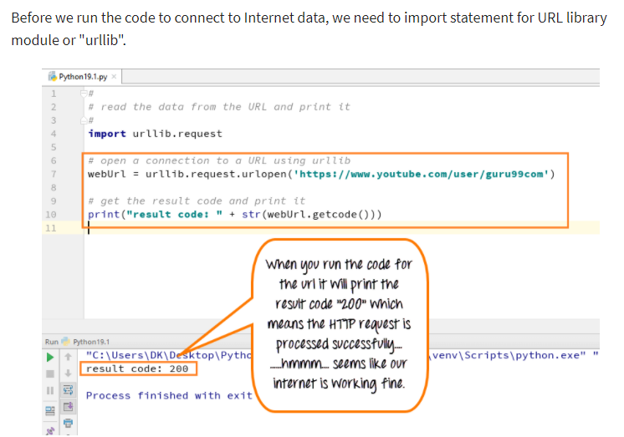
How to Open URL using Urllib

Slide 19
Import urllib
Define your main function
Declare the variable webUrl
Then call the urlopen function on the URL lib library
The URL we are opening is guru99 tutorial on youtube
Next, we going to print the result code
Result code is retrieved by calling the getcode function on the webUrl variable we have created
We going to convert that to a string, so that it can be concatenated with our string "result code"
This will be a regular HTTP code "200", indicating http request is processed successfully
Call the read function on the webURL variable
Read variable allows to read the contents of data files
Read the entire content of the URL into a variable called data
Run the code- It will print the data into HTML format

Slide 20
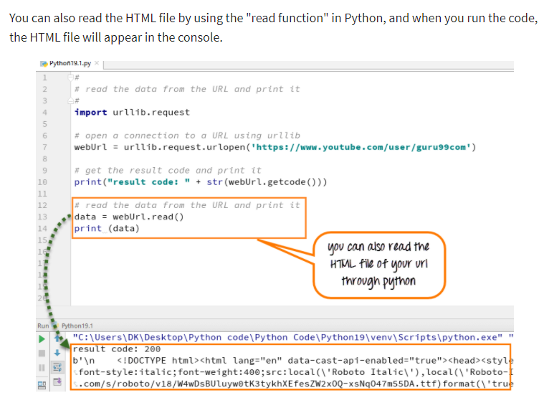
How to get HTML file form URL in Python

Slide 21
sending Email
What is SMTP Server?
Simple Mail Transfer Protocol is an application layer protocol in the OSI model. It lets a user send mail to another. Since this is a push protocol, we can use it to send a mail. At the receiver, this mail is retrieved using protocols POP (Post Office Protocol)and IMAP (Internet Message Access Protocol).
https://medium.com/@rinu.gour123/python-send-email-via-smtp-ad2d259d7240

Slide 22
import smtplib,ssl
content="hello,sending mail from python code"
# Create a secure SSL context
context = ssl.create_default_context()
mail=smtplib.SMTP_SSL("smtp.gmail.com",465, context=context)
mail.login(“senderaddress",“password")
mail.sendmail(“senderaddress",“receiveraddress",content)
print("email sent")
mail.quit()

